Slide 1
Laravel
Beginner
Caspian Consultancy & Services
Copyright 2022

Slide 2
Agenda
What we going to learn
Installation
Create
Authentication
Laravel Mix
Controllers
Routing, Route-Model-Binding
Database Migrations
Model, Model Factories
Laravel String Helpers
Blade Templating, Blade Components, Blade Directives
Eloquent (ORM: Object Relational Mapping), Eloquent Relationships

Slide 3
Agenda
What we going to learn
Authorization
Validation of Form, CSRF protection, Method Spoofing
Middleware
Eager Loading
Pagination & Redirecting
Artisan Console
Dates & Times
Laravel Collections
Soft Deleting
Sending Email

Slide 4
Training Conducted
How we going to learn
Assuming Prior Zero Laravel Knowledge
Step-by-Step (a Bit Theory, Demo, you do…)
Solving issues together
Lot’s of break in between (to avoid fatigue)

Slide 5

Day 1
Setup & Installation

Slide 6
Installation Options
How you can setup Laravel?
Option 1: WAMP, LAMP, MAMP, LARAGON Windows/Linux/MacOS/ Apache, MySQL & PHP When you don’t need to change your Development Env often
Option 2: Homestead / Valet VirtualBox & Vagrant When you might need multiple Development Env
Option 3: Docker Laravel Sail The Preferred Installation for Laravel 9

Slide 7
Installation
Option 1: Program or Package
Install XAMP or WAMP or LAMP or MAMP
Install Composer via CMD or Terminal
Goto This website, https://getcomposer.org/doc/00-intro.md
Follow the instructions
Most Windows Users will use Laragon
Goto This Website, https://laragon.org/

Slide 8
Installation
Option 2: Virtual Machine
Install using HomeStead (Windows 10 & Mac)
For Windows 10 goto this website, https://tutsforweb.com/installing-laravel-homestead-on-windows-step-by-step/
For Mac goto this website, https://dev.to/ko31/installing-laravel-homestead-on-macos-5910
Install using Valet (Mac Only)

Slide 9
Installation
Option 3: Using Docker
Install & Use Docker Docker is a tool designed to make it easier to create, deploy, and run applications by using containers. Containers allow a developer to package up an application with all of the parts it needs, such as libraries and other dependencies, and ship it all out as one package.
Latest Laravel 9, uses Sail, Terminal: curl -s "https://laravel.build/example-app" | bash
Make sure you install Docker Desktop first!

Slide 10
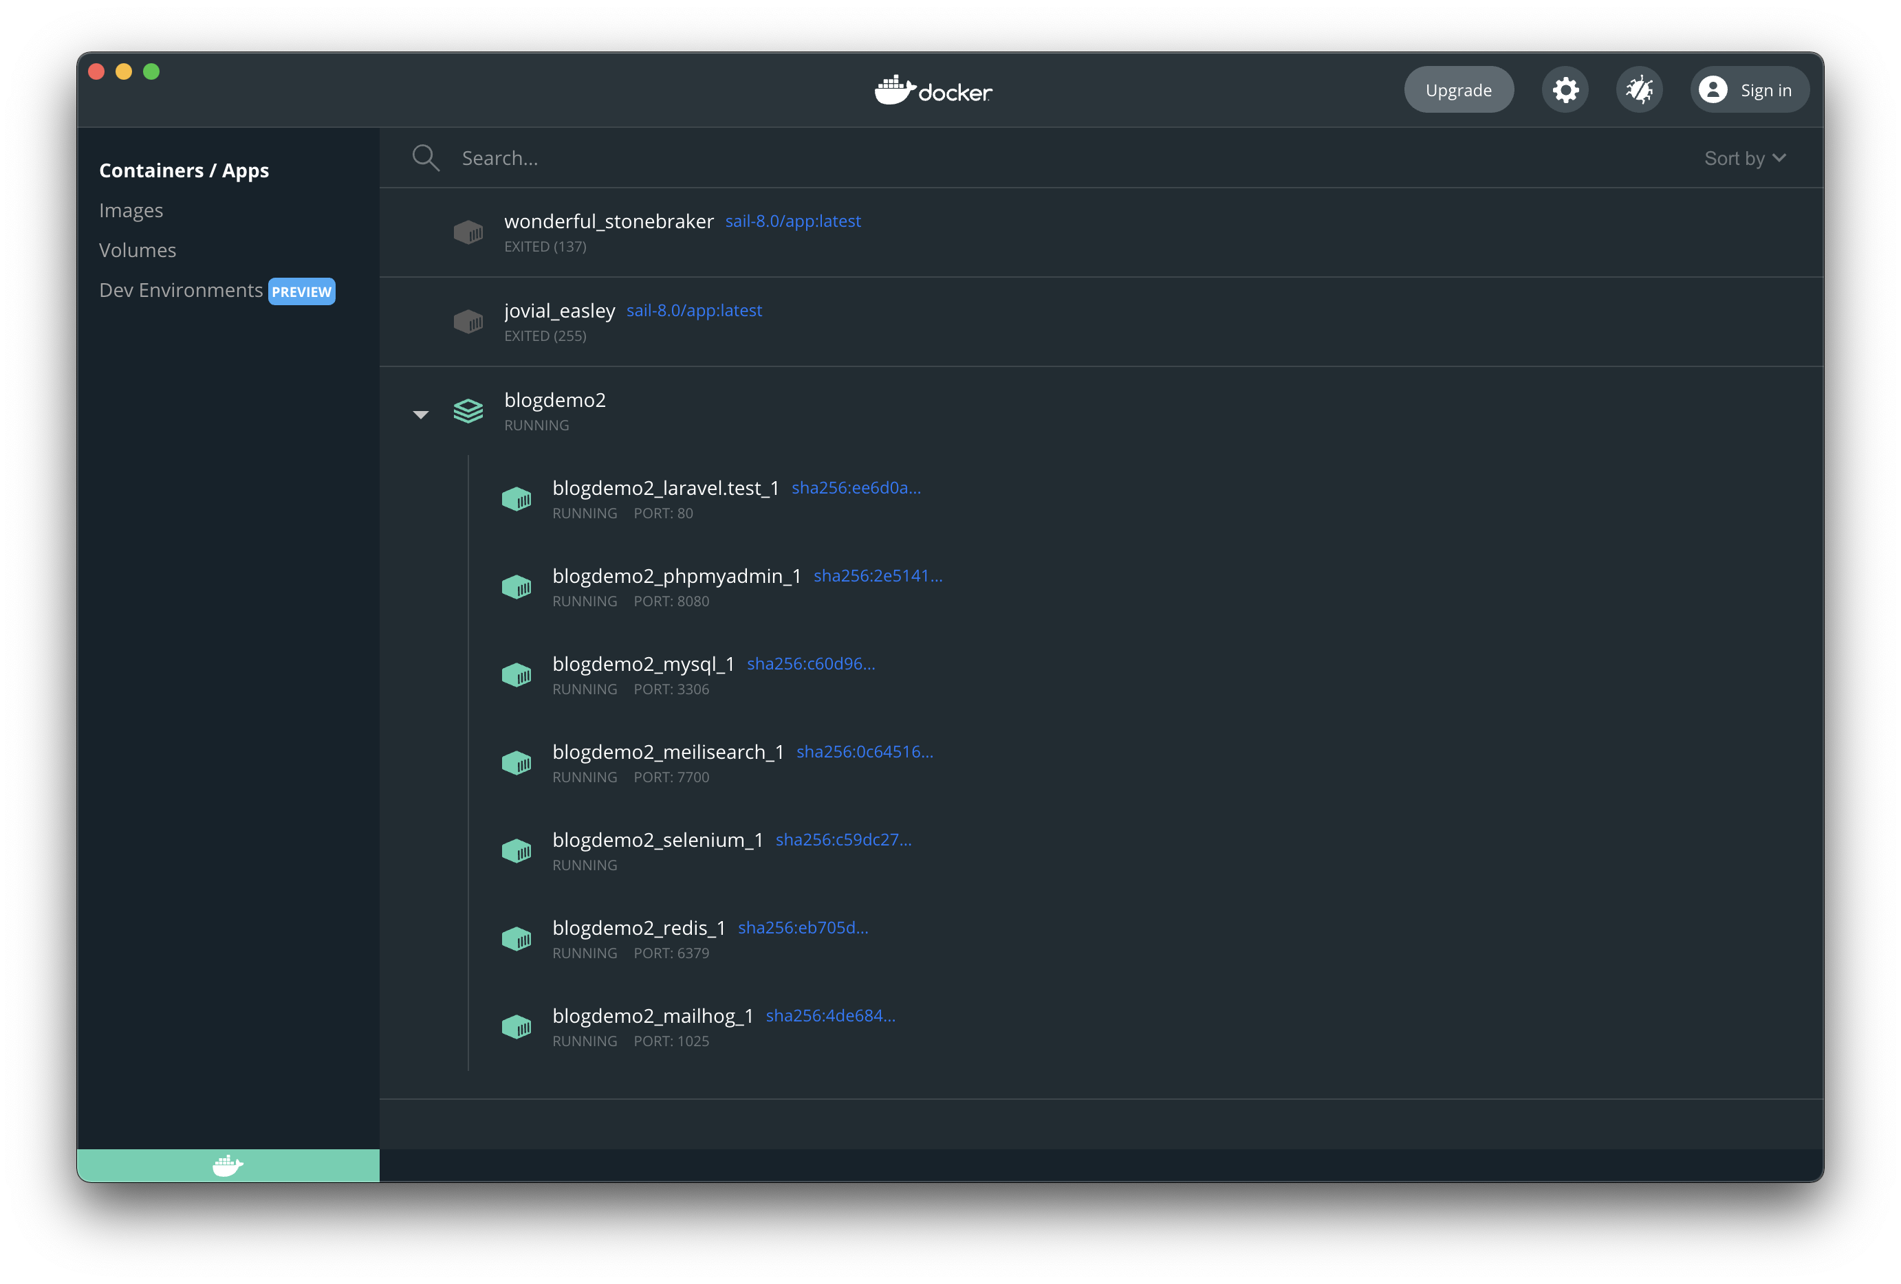
Installation
Option 3: Using Docker

Slide 11
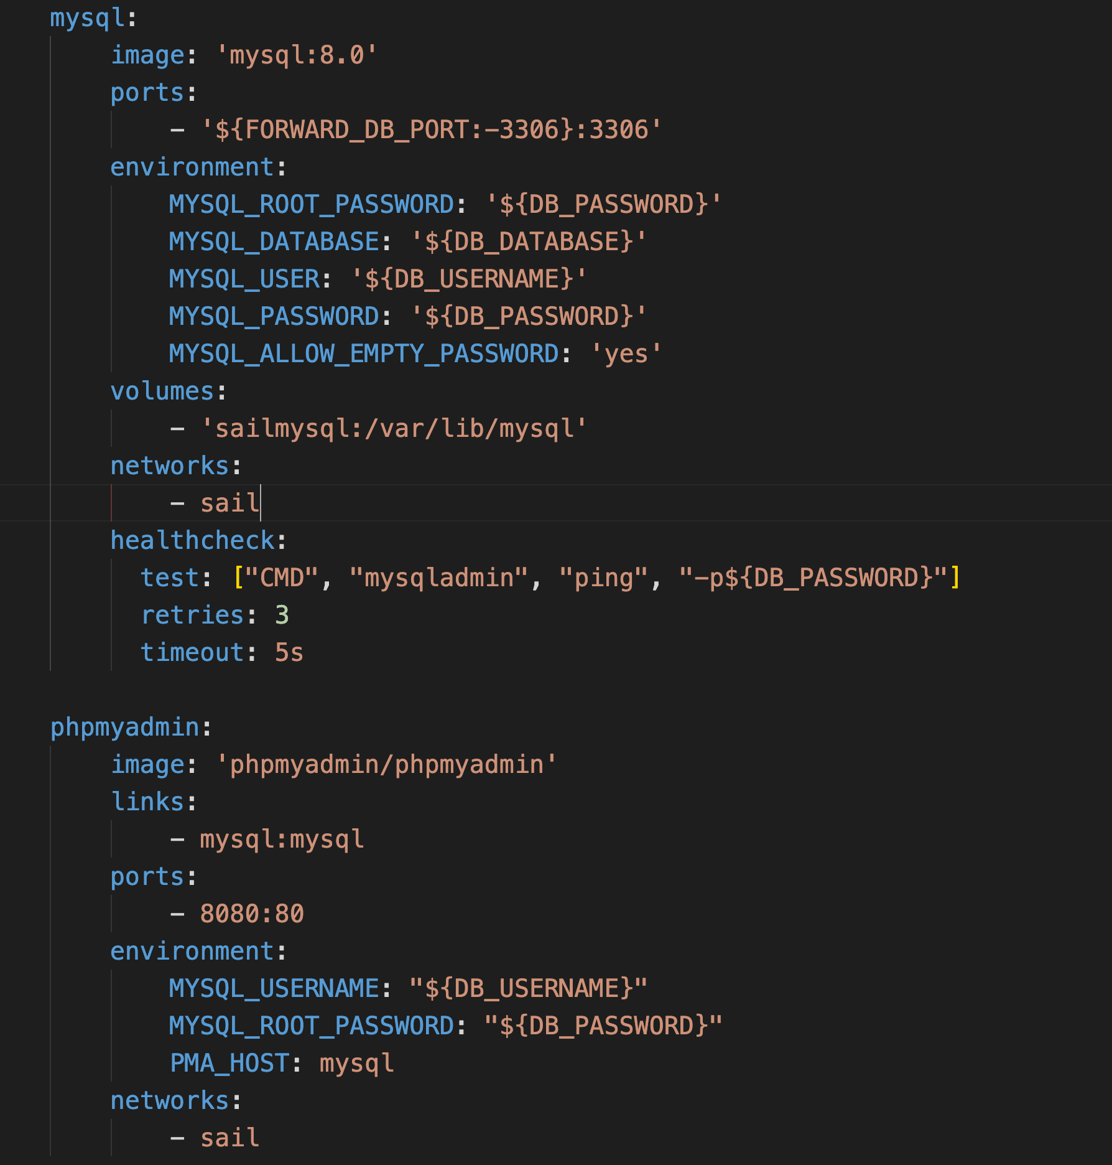
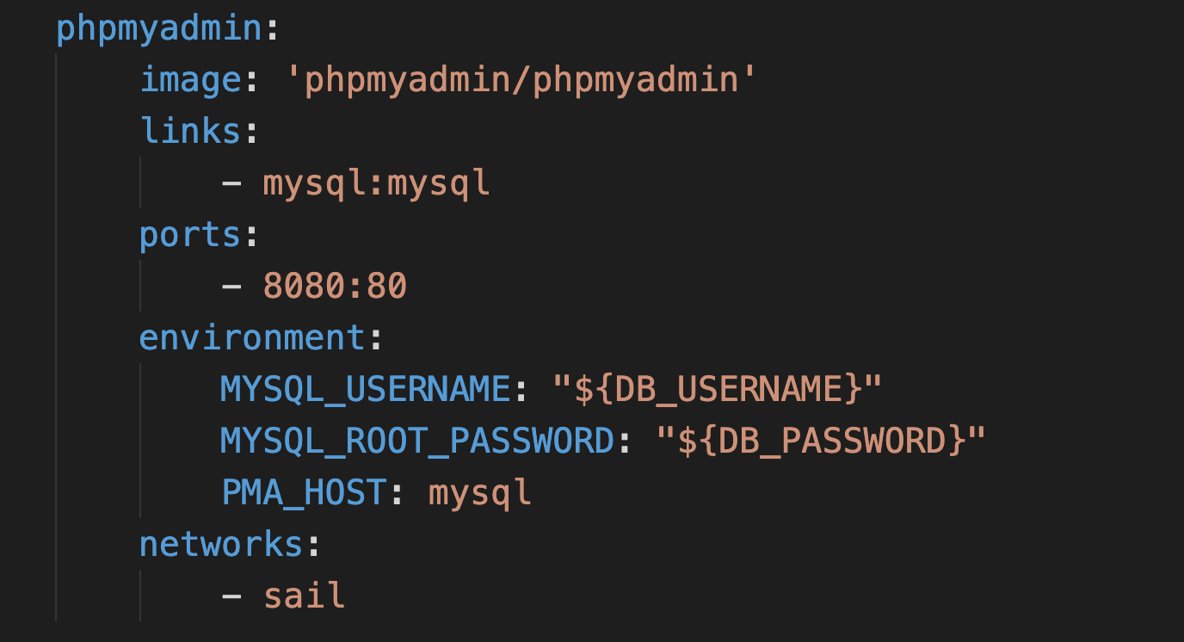
Installation
Option 3: Installing phpMyAdmin in Docker

Slide 12
Create a Laravel project
Using Composer & Laravel
Open CMD or Terminal
Type, composer create-project --prefer-dist laravel/laravel projectname
Some prefer, laravel new projectname
This will create a new Laravel project

Slide 13
Laravel Best Practices

Slide 14
Best Practices
Laravel
Try to follow Laravel Best Practices
This site tried to collect all the best practices, tools and methodologies, so that it could serve a guide for beginners and existing developers alike.
https://github.com/alexeymezenin/laravel-best-practices
Goto Website…

Slide 15
Laravel Extensions
For Users using VSC
Try to install these Extensions or Plugins in VSC
Laravel Blade Snippets
Laravel Snippets
Laravel Blade Spacer
Laravel Artisan
Laravel Goto Controller
Laravel Goto View

Slide 16
What a Project needs?

Slide 17
Basis of Most Projects
CRUD
Most Projects have basic -> CRUD & ACL
Create, to create a form to add data
Read, to read data you have inputed. List or Detail info
Update, to change your data
Delete, to delete your data
The look can vary but it’s all the same basically

Slide 18
Basis of Most Projects
ACL
ACL stands for Access Control List/Level
If you are work on big ERP or Project then you need to control access to certain sections of the web system.
You require to role permissions based access control database design that way you can specify the level of the user.
Roles and Permissions through you can create several types of users with different role and permission

Slide 19
Basis of Most Projects
Using ACL
For example,
User Management
Role Management
Product Management

Slide 20
Basis of Most Projects
Using ACL
For example,
User Management
Role Management
Product Management
This will discuss later more… right now the basics!

Slide 21
Laravel Basics

Slide 22
Laravel Basics
In a Nutshell
You create a Laravel Project
You create a database
You create a Migration file (later can do more) then Migrate
You create a Model (later can do more)
Then you create a ModelController to give functions to the Model
You define/create Routes in the Functions; you can also use Route/Web.php
You create Views so that it display webpage where your routing goes

Slide 23
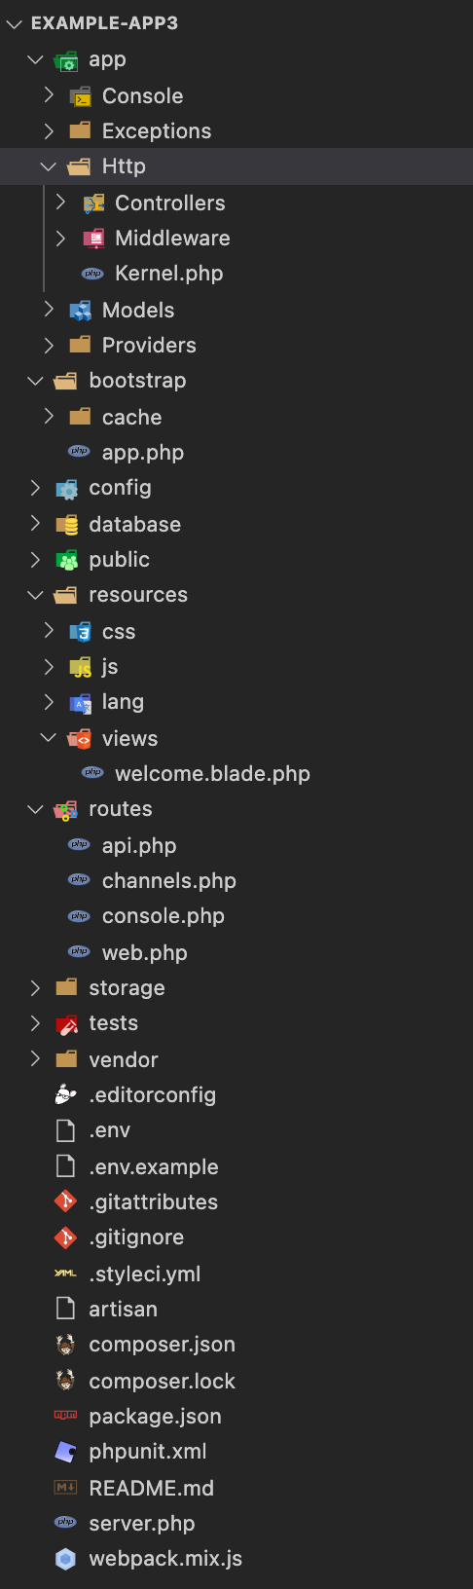
Laravel File Directory
In a Nutshell
Frequently used Directories you will use:
App
Models
http/controllers
Resources/views/
Routes/web.php
Routes/api.php (API)

Slide 24
Adding CSS

Slide 25
Laravel Basics
In a Nutshell
Refer to : webpack.mix.js file
You can use Bootstrap or Tailwindcss (goto tailwindcss.com/docs/installation)
Checkout Installation for Laravel mix —> require(`tailwindcss’)
In folder >resources>css>app.css add: @railwind base; @tailwind components; @tailwind utilities;
Terminal: npm install -D tailwindcss@latest postcss@latest autoprefixer@latest
Terminal: npx tailwindcss init
Add Purge in Tailwind.config.js
Terminal: npm run dev (to update changes) or npm run watch (listen to any changes)
Add this to Layouts.blade.php <link rel="stylesheet" href="{{ asset('css/app.css') }}”>

Slide 26
Tailwind Basics
In a Nutshell
Refer to : tailwindcss.com
Why use Tailwind? Tailwind CSS is a utility-first library, which simply means that, unlike Bootstrap, Tailwind doesn't provide automatically prestyled components. Rather, it provides utility classes that help us style our components in certain ways and allow us to build our own classes
Read more —> https://blog.logrocket.com/tailwind-css-vs-bootstrap-ui-kits/

Slide 27
Laravel String Helpers

Slide 28
Laravel String Helpers
In a Nutshell
asset eg: <link rel="stylesheet" href="{{ asset('css/app.css') }}">
route eg: <a href="{{ route('dashboard') }}" class="p-3">Dashboard</a>

Slide 29
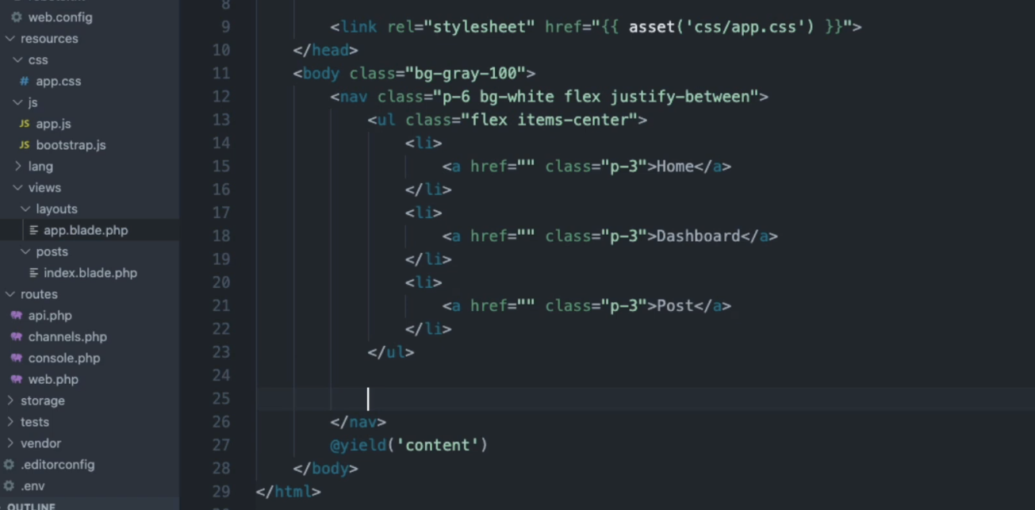
Laravel So far…
Create Navigation bar at the top

Slide 30
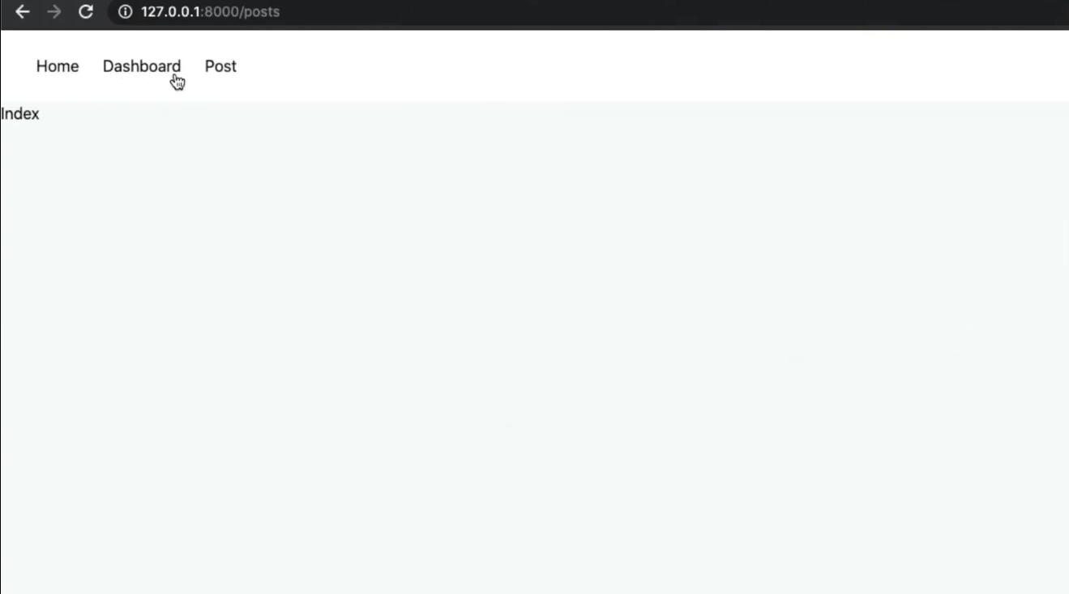
Laravel So far…
End result…

Slide 31
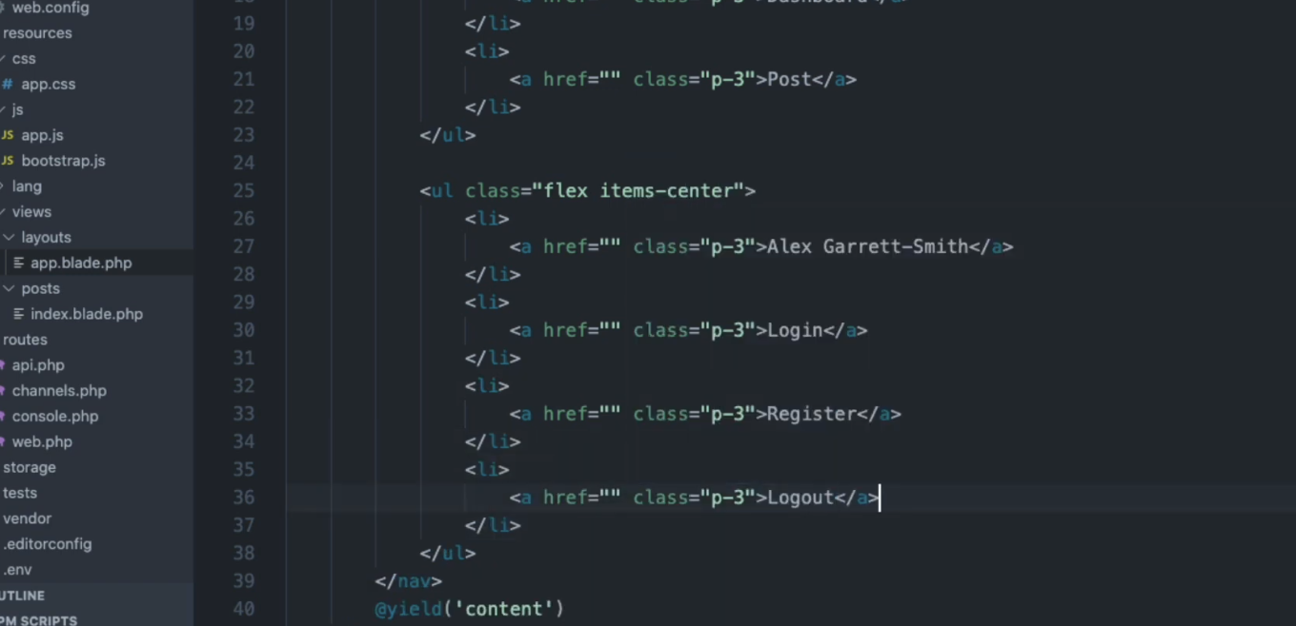
Laravel So far…
Add when you Login…

Slide 32
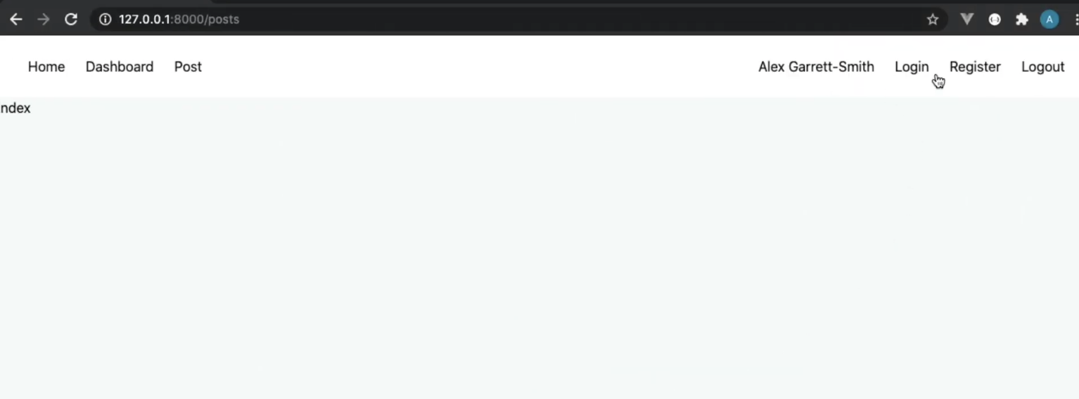
Laravel So far…
Add when you Login…

Slide 33
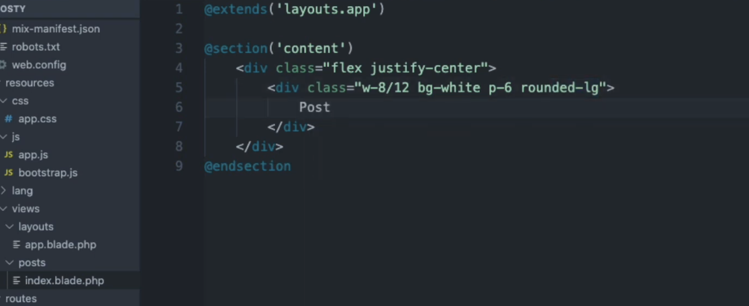
Laravel So far…
For the Content…

Slide 34
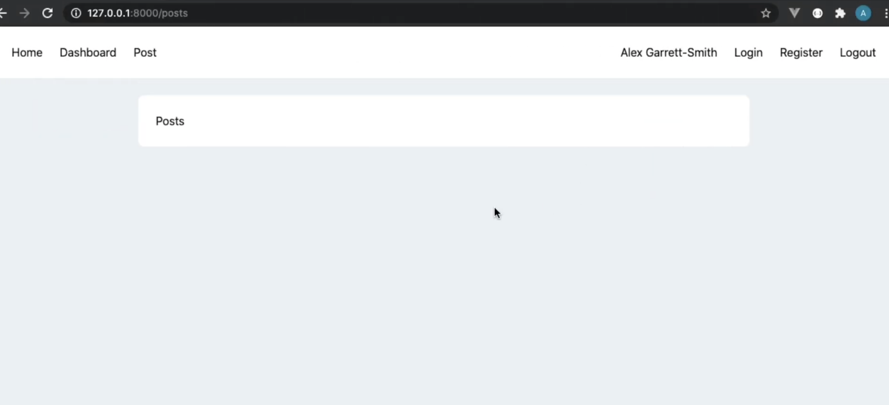
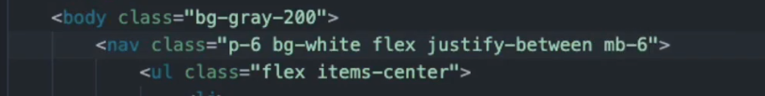
Laravel So far…
For the Content…

Slide 35
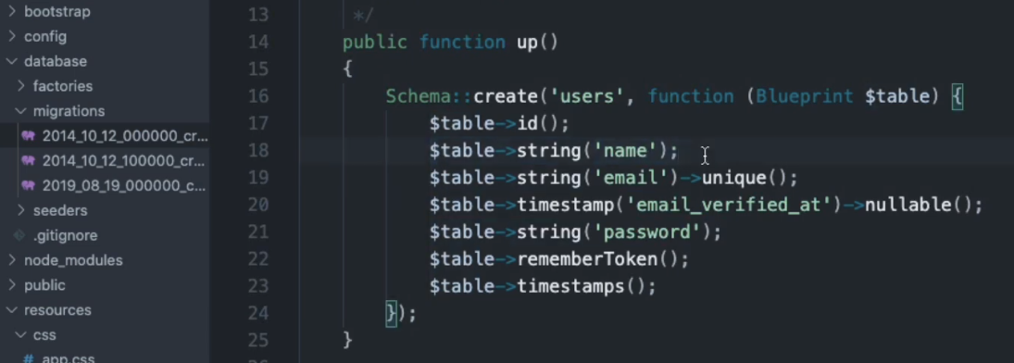
Laravel Authentication…
We need to understand Migration First…
Laravel Has Preset Tables & Fields Created
We will use the default for now…
Onwards to understand Migration…

Slide 36
Laravel Migrations

Slide 37
Laravel Migrations
In a Nutshell
Before you do migration, you create Models
Terminal: php artisan make:model post -m
After you create the model, you can create any fields you like
Demo…
Before you First time migrate, make sure .env file have specify database info
Terminal: php artisan migrate
Demo…

Slide 38
Model
Laravel Basics
You create a Model using:
Php artisan make: model yourmodelname
If you would like to generate a database migration when you generate the model, you may use the --migration or -m option:
php artisan make:model yourmodelname --migration
php artisan make:model yourmodelname -m
Note: Model name is Sentence case

Slide 39
Migration
Migration Basics
migrate:Install - runs automatically, no need to worry
migrate:reset - rollback
migrate:refresh - rollback everything and rerun migration back
migrate:fresh - rollback same as refresh but doesn’t care with “down” migrations
migration:rollback - rollback previous one
migrate:status
Note: Model name is Sentence case

Slide 40
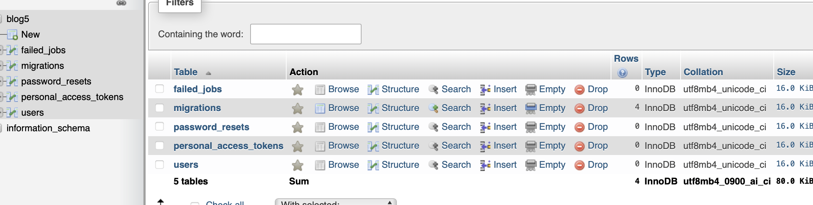
Laravel So far…
For the Migration…
Before
Terminal: php artisan make:migration add-username_to_users_table

Slide 41
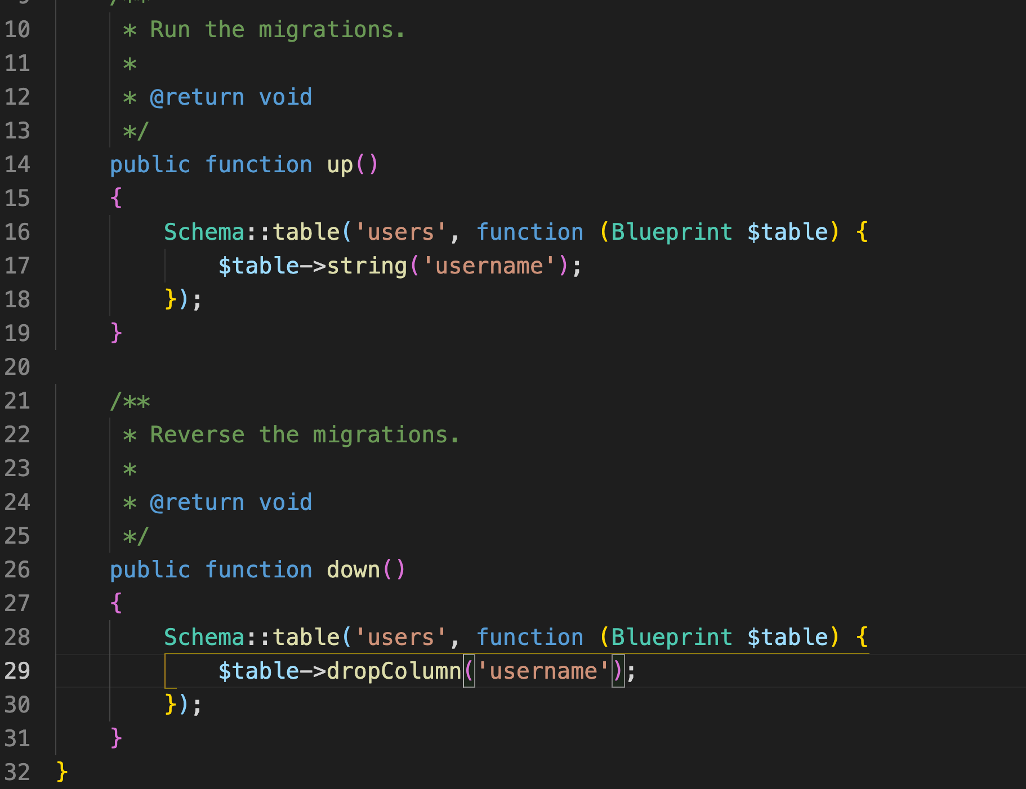
Laravel So far…
For the Migration…
Then run migrate

Slide 42
Laravel Controllers

Slide 43
Laravel Migrations
In a Nutshell
Terminal: php artisan make:controller yourcontrollername -resource
Eg: php artisan make:controller Auth\\RegisterController to organise our Controllers we can use \\ to create folders

Slide 44
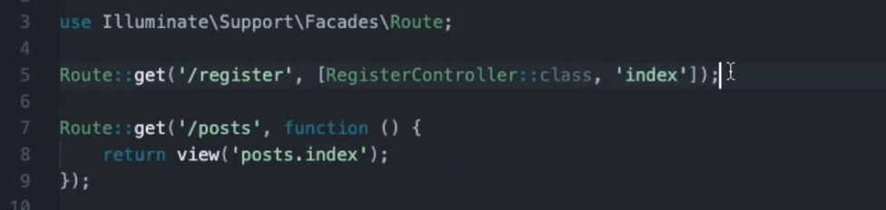
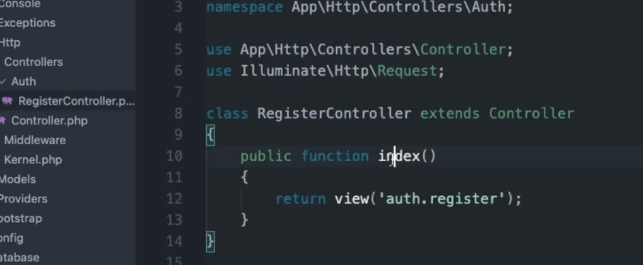
Laravel So Far
We are going to Create Controllers…
Terminal: php artisan make:controller Auth\\RegisterController
Next we add Route in web.php
Don’t forget to import class

Slide 45
Laravel So Far
We are going to Create Controllers…
In our RegisterController, Create an Index function
Don’t forget to create Register view

Slide 46
Laravel So Far
Routes for our RegisterController Index
In our Route file
Why we use name? So that we can use {{ route(“register”) }} Helper Syntax in our href URL regardless original URL changes

Slide 47
Laravel So Far
Create Views
Create Register Views & Login Views
Demo…
Validate fields in our views
Demo…

Slide 48
Laravel Routing

Slide 49
Routing
Laravel Basics
The most basic Laravel routes accept a URI and a Closure, providing a very simple and expressive method of defining routes:
All Laravel routes are defined in your route files, which are located in the routes directory.
The routes/web.php
Route::get('foo', function () {
return 'Hello World';
});

Slide 50
Routing
Laravel Basics
For example, you may access the following route by navigating to http://your-app.test/user in your browser:
You need to create a View for index.blade.php later!
Route::get('/user', 'UserController@index');

Slide 51
Laravel Templating

Slide 52
Views
Laravel Basics
You create a View in the /resources/views/ folder,
A simple View might look something like this:
<!-- View stored in resources/views/greeting.blade.php -->
<html>
<body>
<h1>Hello, {{ $name }}</h1>
</body>
</html>
Note: The CSRF middleware is automatically disabled when running tests.

Slide 53
Views
Laravel Basics
This view is stored at resources/views/greeting.blade.php,
We may return it using the global view helper like so:
Route::get('/', function () {
return view('greeting', ['name' => 'James']);
});

Slide 54
Controllers
Laravel Basics
You create a Controller using:
Php artisan make: controller yourcontrollername

Slide 55
CSRF Protection
Laravel Basics
Laravel makes it easy to protect your application from cross-site request forgery (CSRF) attacks.
Laravel automatically generates a CSRF "token" for each active user session managed by the application.
You may use the @csrf Blade directive to generate the token field:
<form method="POST" action="/profile">
@csrf
...
</form>
Note: The CSRF middleware is automatically disabled when running tests.

Slide 56
Task Today
Laravel Basics
Learn Basic Laravel Syntax
Create basic Web pages for our CMS
Create Auth & Login/Logout

Slide 57
Day 2
User Role & Permission

Slide 58
User Role & Permission

Slide 59

Laravel Spatie
User Roles & Permission Package
Step 1: Laravel Installation. ...
Step 2: Spatie Package Installation. ...
Step 3: Create Table using Migrations. ...
Step 4: Create Table Models. ...
Step 5: Add Middleware. ...
Step 6: Create Seeder For Permissions. ...
Step 7: Create Authentication. ...
Step 8: Create Routes.
https://www.itsolutionstuff.com/post/laravel-56-user-roles-and-permissions-acl-using-spatie-tutorialexample.html

Slide 60
Error Handling

Slide 61
Error handling
101
When you start a new Laravel project, error and exception handling is already configured for you.

Slide 62
Dashboard

Slide 63
Seeder

Slide 64
Laravel Seeder
What is a Seeder? How to Create One?
Laravel introduce seeder for creating testing data
Create Seeder Command:
php artisan make:seeder AdminUserSeeder
It will create one file AdminUserSeeder.php on seeds folder
All seed classes are stored in the database/seeds directory

Slide 65
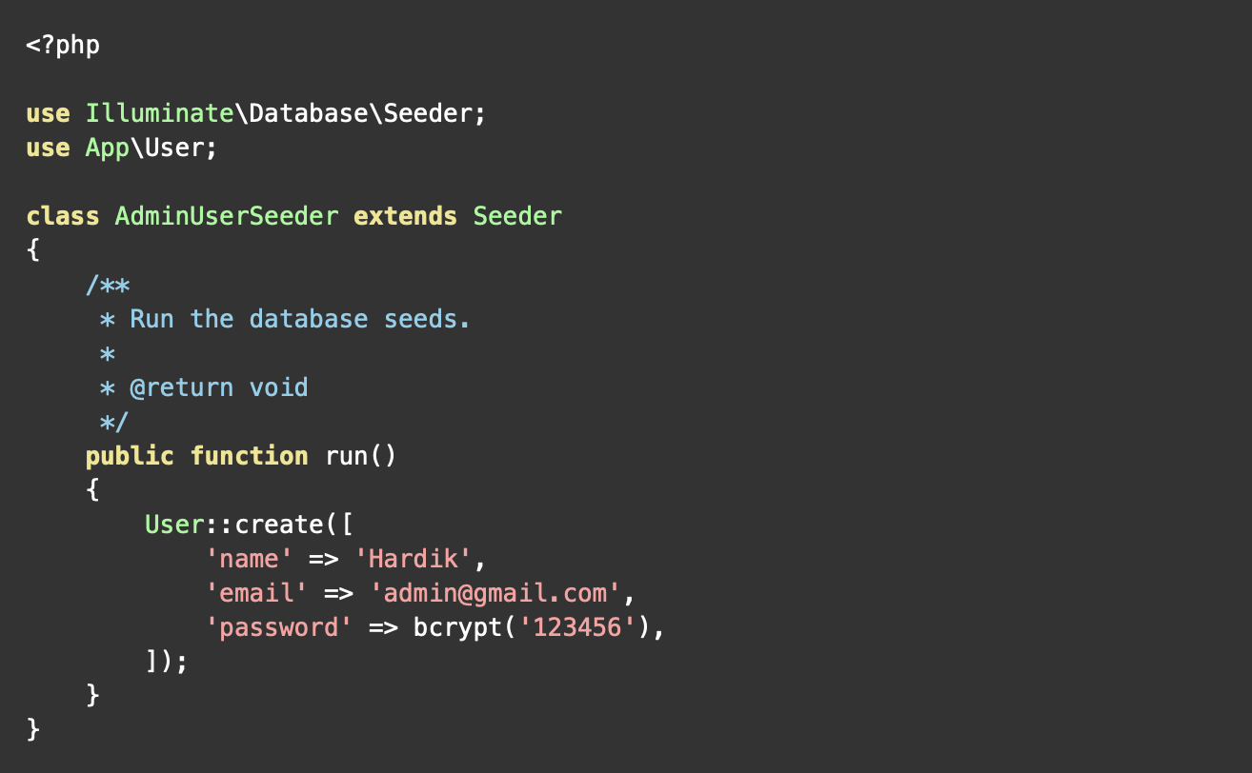
Laravel Seeder
Coding Seeder
You can write code of create admin user using model in Laravel
database/seeds/AdminUserSeeder.php

Slide 66
Laravel Seeder
Running Single Seeder
To run single seeder:
php artisan db:seed -- class=AdminUserSeeder

Slide 67
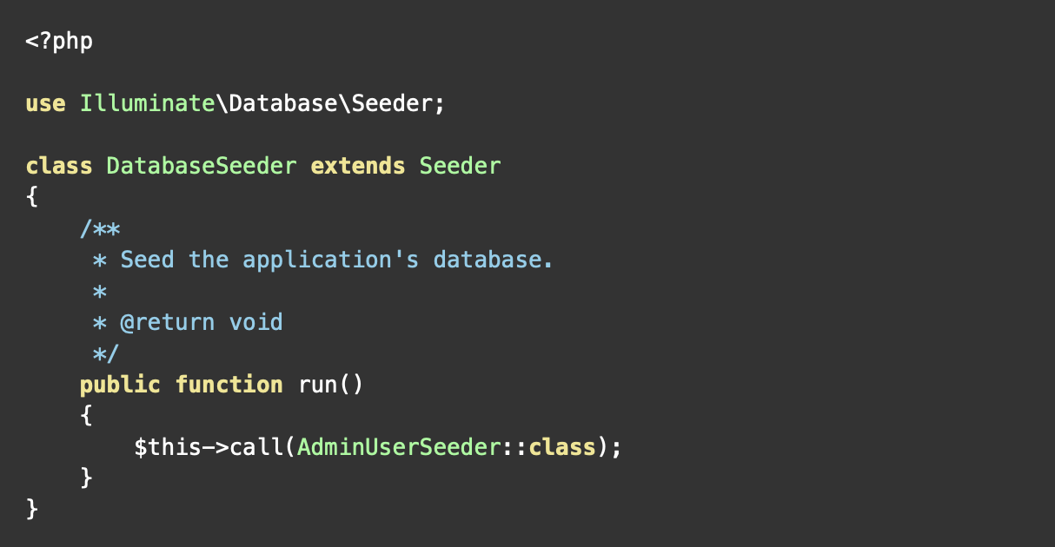
Laravel Seeder
Running Seeders
To run all seeders:
declare your seeder in DatabaseSeeder class file. then you have to run single command to run all listed seeder class.

Slide 68
Create Project

Slide 69
CMS Blog (CRUD)

Slide 70
Create Blog
Step 1
Create a New Project:
composer create-project --prefer-dist laravel/laravel blog or
Laravel new blog or
curl -s "https://laravel.build/blog" | bash

Slide 71
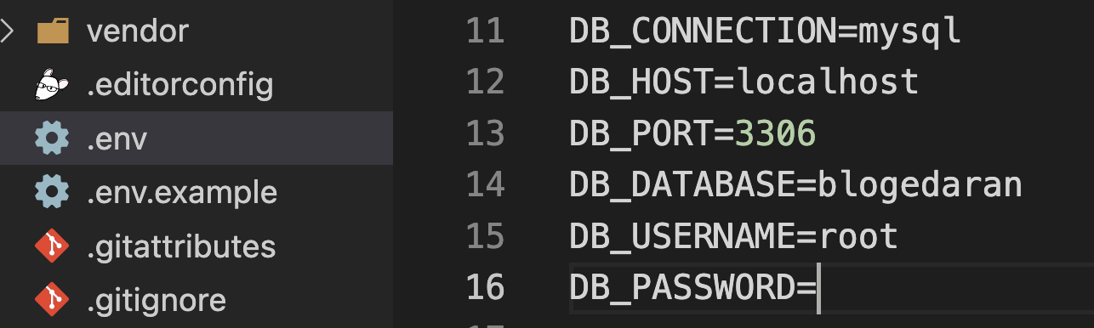
Create Blog
Step 2
Create Database Configuration in .env:

Slide 72
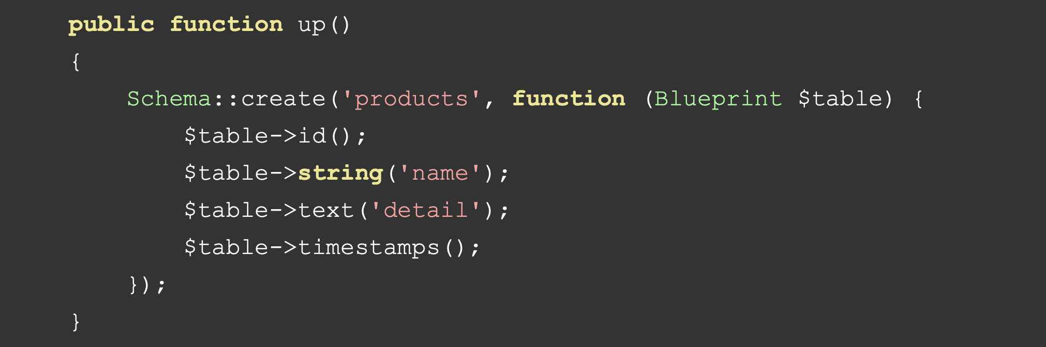
Create Blog
Step 3
Create migration:
Terminal> php artisan make:migration create_products_table —create=products
Then add name and detail below:
Terminal> php artisan migrate

Slide 73
Create Blog
Step 4
Create Controller:
Terminal > php artisan make:controller productsController or
Terminal > php artisan make:controller productsController -- resources

Slide 74
Create Blog
Step 4
Create Route:
In routes/web.php
use App\Http\Controllers\ProductController;
Route::resource('products', ProductController::class);

Slide 75
Create Blog
Step 5
Create Controller & Model:
Terminal> php artisan make:controller ProductController --resource —model=Product
We combine together but we can create separately.
In this path “app/Http/Controllers/ProductController.php”, add 7 functions

Slide 76
Create Blog
Step 5
Create 7 functions in the controller,
1. index()
2. create()
3. store()
4. show()
5. edit()
6. update()
7. destroy()

Slide 77
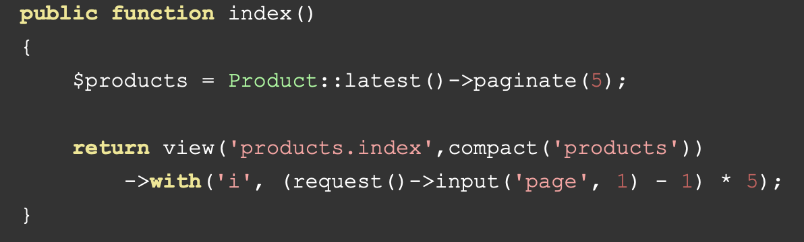
Create Blog
Step 5
Create 7 functions in the controller,
1. index()

Slide 78
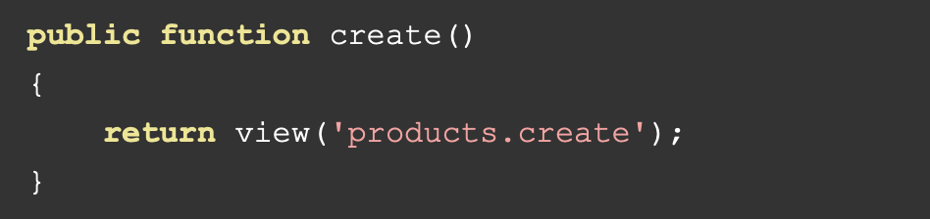
Create Blog
Step 5
Create 7 functions in the controller,
2. create()

Slide 79
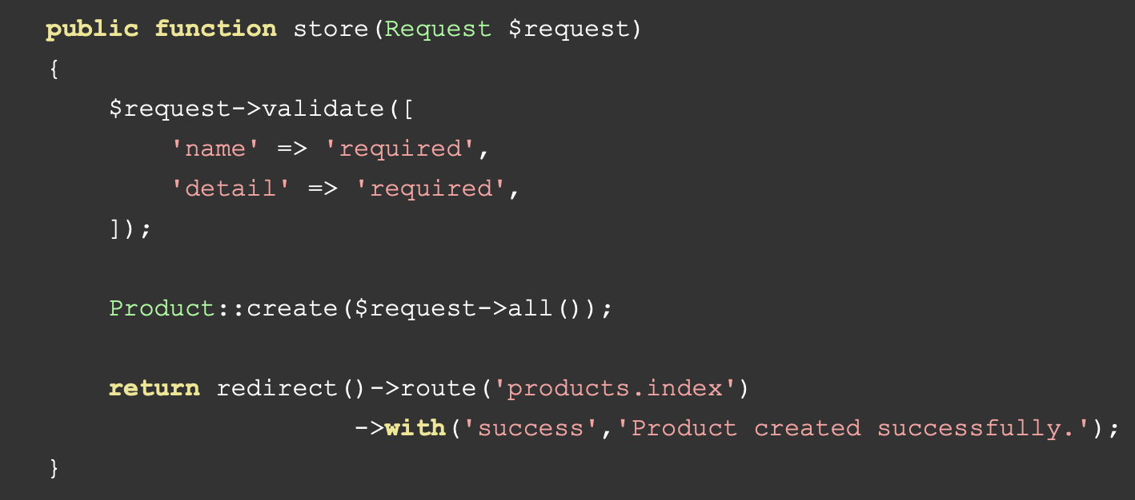
Create Blog
Step 5
Create 7 functions in the controller,
3. store()

Slide 80
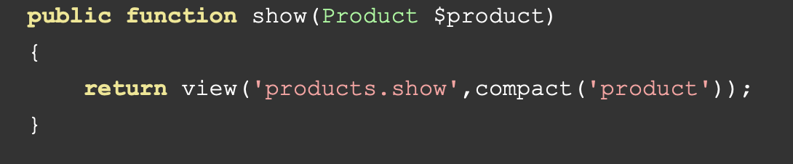
Create Blog
Step 5
Create 7 functions in the controller,
4. show()

Slide 81
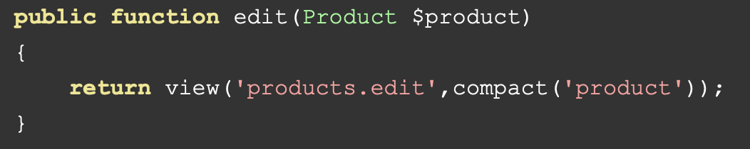
Create Blog
Step 5
Create 7 functions in the controller,
5. edit()

Slide 82
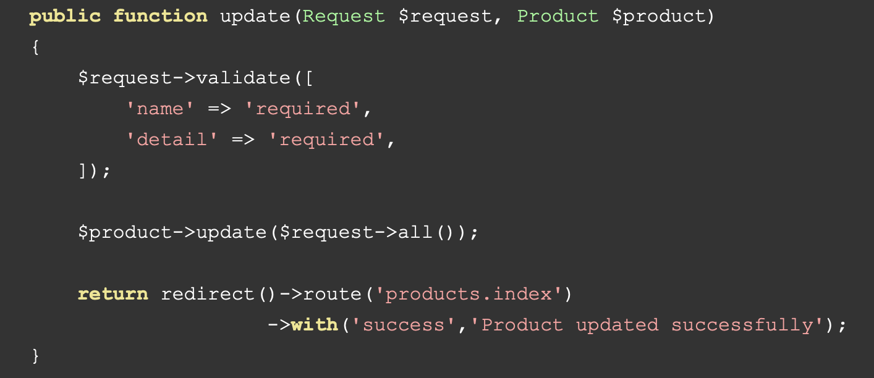
Create Blog
Step 5
Create 7 functions in the controller,
6. update()

Slide 83
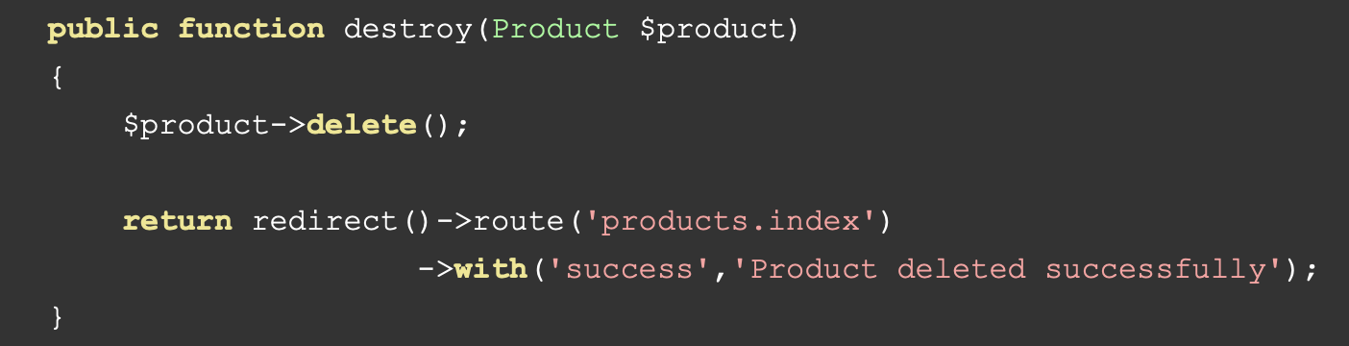
Create Blog
Step 5
Create 7 functions in the controller,
7. destroy()

Slide 84
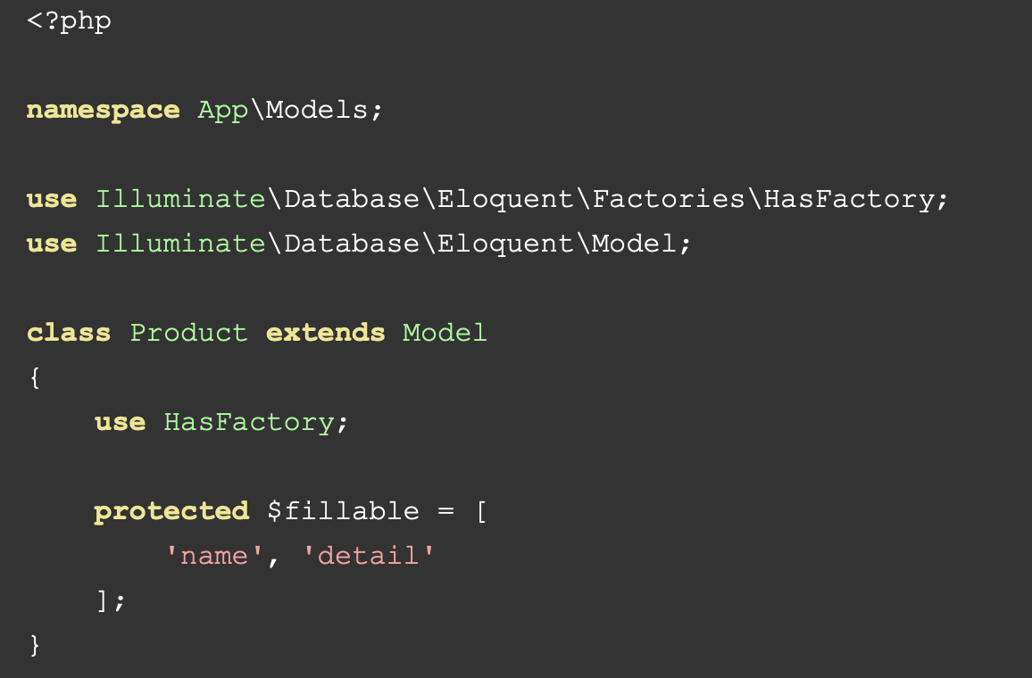
Create Blog
Step 5
Find "app/Models/Product.php" and put bellow content in Product.php file: app/Models/Product.php

Slide 85
Create Blog
Step 6
Add Blades files in Resources/View
1. layout.blade.php
2. index.blade.php
3. create.blade.php
4. edit.blade.php

Slide 86
Create Blog
Step 6
Create:
1. layout.blade.php
<!DOCTYPE html>
<html>
<head>
<title>Laravel 8 CRUD</title>
<link href="https://cdnjs.cloudflare.com/ajax/libs/twitter-bootstrap/4.0.0-alpha/css/bootstrap.css" rel="stylesheet">
</head>
<body>
<div class="container">
@yield('content')
</div>
</body>
</html>

Slide 87
Create Blog
Step 6
Create:
2. index.blade.php
@extends('products.layout')
@section('content')
<div class="row">
<div class="col-lg-12 margin-tb">
<div class="pull-left">
<h2>Laravel 8 CRUD</h2>
</div>
<div class="pull-right">
<a class="btn btn-success" href="{{ route('products.create') }}"> Create New Product</a>
</div>
</div>
</div>
@if ($message = Session::get('success'))
<div class="alert alert-success">
<p>{{ $message }}</p>
</div>
@endif
<table class="table table-bordered">
<tr>
<th>No</th>
<th>Name</th>
<th>Details</th>
<th width="280px">Action</th>
</tr>
@foreach ($products as $product)
<tr>
<td>{{ ++$i }}</td>
<td>{{ $product->name }}</td>
<td>{{ $product->detail }}</td>
<td>
<form action="{{ route('products.destroy',$product->id) }}" method="POST">
<a class="btn btn-info" href="{{ route('products.show',$product->id) }}">Show</a>
<a class="btn btn-primary" href="{{ route('products.edit',$product->id) }}">Edit</a>
@csrf
@method('DELETE')
<button type="submit" class="btn btn-danger">Delete</button>
</form>
</td>
</tr>
@endforeach
</table>
{!! $products->links() !!}
@endsection

Slide 88
Create Blog
Step 6
Create:
3. create.blade.php
@extends('products.layout')
@section('content')
<div class="row">
<div class="col-lg-12 margin-tb">
<div class="pull-left">
<h2>Add New Product</h2>
</div>
<div class="pull-right">
<a class="btn btn-primary" href="{{ route('products.index') }}"> Back</a>
</div>
</div>
</div>
@if ($errors->any())
<div class="alert alert-danger">
<strong>Whoops!</strong> There were some problems with your input.<br><br>
<ul>
@foreach ($errors->all() as $error)
<li>{{ $error }}</li>
@endforeach
</ul>
</div>
@endif
<form action="{{ route('products.store') }}" method="POST">
@csrf
<div class="row">
<div class="col-xs-12 col-sm-12 col-md-12">
<div class="form-group">
<strong>Name:</strong>
<input type="text" name="name" class="form-control" placeholder="Name">
</div>
</div>
<div class="col-xs-12 col-sm-12 col-md-12">
<div class="form-group">
<strong>Detail:</strong>
<textarea class="form-control" style="height:150px" name="detail" placeholder="Detail"></textarea>
</div>
</div>
<div class="col-xs-12 col-sm-12 col-md-12 text-center">
<button type="submit" class="btn btn-primary">Submit</button>
</div>
</div>
</form>
@endsection

Slide 89
Create Blog
Step 6
Create:
4. edit.blade.php
@extends('products.layout')
@section('content')
<div class="row">
<div class="col-lg-12 margin-tb">
<div class="pull-left">
<h2>Edit Product</h2>
</div>
<div class="pull-right">
<a class="btn btn-primary" href="{{ route('products.index') }}"> Back</a>
</div>
</div>
</div>
@if ($errors->any())
<div class="alert alert-danger">
<strong>Whoops!</strong> There were some problems with your input.<br><br>
<ul>
@foreach ($errors->all() as $error)
<li>{{ $error }}</li>
@endforeach
</ul>
</div>
@endif
<form action="{{ route('products.update',$product->id) }}" method="POST">
@csrf
@method('PUT')
<div class="row">
<div class="col-xs-12 col-sm-12 col-md-12">
<div class="form-group">
<strong>Name:</strong>
<input type="text" name="name" value="{{ $product->name }}" class="form-control" placeholder="Name">
</div>
</div>
<div class="col-xs-12 col-sm-12 col-md-12">
<div class="form-group">
<strong>Detail:</strong>
<textarea class="form-control" style="height:150px" name="detail" placeholder="Detail">{{ $product->detail }}</textarea>
</div>
</div>
<div class="col-xs-12 col-sm-12 col-md-12 text-center">
<button type="submit" class="btn btn-primary">Submit</button>
</div>
</div>
</form>
@endsection

Slide 90
Create Blog
Step 6
Create:
5. show.blade.php
@extends('products.layout')
@section('content')
<div class="row">
<div class="col-lg-12 margin-tb">
<div class="pull-left">
<h2> Show Product</h2>
</div>
<div class="pull-right">
<a class="btn btn-primary" href="{{ route('products.index') }}"> Back</a>
</div>
</div>
</div>
<div class="row">
<div class="col-xs-12 col-sm-12 col-md-12">
<div class="form-group">
<strong>Name:</strong>
{{ $product->name }}
</div>
</div>
<div class="col-xs-12 col-sm-12 col-md-12">
<div class="form-group">
<strong>Details:</strong>
{{ $product->detail }}
</div>
</div>
</div>
@endsection

Slide 91
Create Blog
Step 7
We run:
Terminal> php artisan serve

Slide 92
CMS Blog (Authentication)

Slide 93
CMS Auth
Step 1
We use composer to add additional package:
Terminal> composer require laravel/ui
Then we setup Auth Scaffolding, can use any one of these:
Terminal > php artisan ui bootstrap —auth or
Terminal > php artisan ui vue —auth or
Terminal > php artisan ui react —auth

Slide 94
CMS Auth
Step 2
We run npm install && npm run dev:
Terminal> npm install && npm run dev
Refresh your browser (if your server is already on) or php artisan serve

Slide 95
CMS Role & Permission

Slide 96
CMS Role & Permission
Intro
We will do 3 Management Roles:
User Management
Role Management
Product Management

Slide 97
CMS Role & Permission
Step 1
We will need these:
Spatie Package Terminal> composer require spatie/laravel-permission
Laravel Collective Terminal > composer require laravelcollective/html
In config/Permission.php Terminal> php artisan vendor:publish —provider=“Spatie\Permission\PermissionServiceProvider"
We need to migrate so that we will have Permission table in our Database Terminal> php artisan migrate

Slide 98
CMS Role & Permission
Step 2
In app/Models/User.php:
Add Spatie:
use Spatie\Permission\Traits\HasRoles;
And also add HasRoles to the class:
use HasApiTokens, HasFactory, Notifiable, HasRoles;

Slide 99
CMS Role & Permission
Step 3
In app/Http/Kernel.php:
Add middleware:
....
protected $routeMiddleware = [
....
'role' => \Spatie\Permission\Middlewares\RoleMiddleware::class,
'permission' => \Spatie\Permission\Middlewares\PermissionMiddleware::class,
'role_or_permission' => \Spatie\Permission\Middlewares\RoleOrPermissionMiddleware::class,
]
....

Slide 100
CMS Role & Permission
Step 4
Add Routes:
Auth::routes(); Route::group(['middleware' => ['auth']], function() {
Route::resource('roles', RoleController::class);
Route::resource('users', UserController::class);
Route::resource('products', ProductController::class);
});

Slide 101
CMS Role & Permission
Step 5
We will add additional controllers:
ProductController (Done Already)
UserController Terminal>php artisan make:controller UserController
RoleController Terminal>php artisan make:controller RoleController

Slide 102
CMS Role & Permission
Step 5: UserController
<?php
namespace App\Http\Controllers;
use Illuminate\Http\Request;
use App\Http\Controllers\Controller;
use App\Models\User;
use Spatie\Permission\Models\Role;
use DB;
use Hash;
use Illuminate\Support\Arr;
class UserController extends Controller
{
public function index(Request $request)
{
$data = User::orderBy('id','DESC')->paginate(5);
return view('users.index',compact('data'))
->with('i', ($request->input('page', 1) - 1) * 5);
}

Slide 103
CMS Role & Permission
Step 5: UserController
public function create()
{
$roles = Role::pluck('name','name')->all();
return view('users.create',compact('roles'));
}
public function store(Request $request)
{
$this->validate($request, [
'name' => 'required',
'email' => 'required|email|unique:users,email',
'password' => 'required|same:confirm-password',
'roles' => 'required'
]);
$input = $request->all();
$input['password'] = Hash::make($input['password']);
$user = User::create($input);
$user->assignRole($request->input('roles'));
return redirect()->route('users.index')
->with('success','User created successfully');
}

Slide 104
CMS Role & Permission
Step 5: UserController
public function show($id)
{
$user = User::find($id);
return view('users.show',compact('user'));
}
public function edit($id)
{
$user = User::find($id);
$roles = Role::pluck('name','name')->all();
$userRole = $user->roles->pluck('name','name')->all();
return view('users.edit',compact('user','roles','userRole'));
}

Slide 105
CMS Role & Permission
Step 5: UserController
public function update(Request $request, $id)
{
$this->validate($request, [
'name' => 'required',
'email' => 'required|email|unique:users,email,'.$id,
'password' => 'same:confirm-password',
'roles' => 'required'
]);
$input = $request->all();
if(!empty($input['password'])){
$input['password'] = Hash::make($input['password']);
}else{
$input = Arr::except($input,array('password'));
}
$user = User::find($id);
$user->update($input);
DB::table('model_has_roles')->where('model_id',$id)->delete();
$user->assignRole($request->input('roles'));
return redirect()->route('users.index')
->with('success','User updated successfully');
}

Slide 106
CMS Role & Permission
Step 5: UserController
public function destroy($id)
{
User::find($id)->delete();
return redirect()->route('users.index')
->with('success','User deleted successfully');
}
}

Slide 107
CMS Role & Permission
Step 6: ProductController
Add this to ProductController role and Permission:
function __construct()
{
$this->middleware('permission:product-list|product-create|product-edit|product-delete', ['only' => ['index','show']]);
$this->middleware('permission:product-create', ['only' => ['create','store']]);
$this->middleware('permission:product-edit', ['only' => ['edit','update']]);
$this->middleware('permission:product-delete', ['only' => ['destroy']]);
}

Slide 108
CMS Role & Permission
Step 7: RoleController
Add this to RoleController role and Permission:
function __construct()
{
$this->middleware('permission:product-list|product-create|product-edit|product-delete', ['only' => ['index','show']]);
$this->middleware('permission:product-create', ['only' => ['create','store']]);
$this->middleware('permission:product-edit', ['only' => ['edit','update']]);
$this->middleware('permission:product-delete', ['only' => ['destroy']]);
}

Slide 109
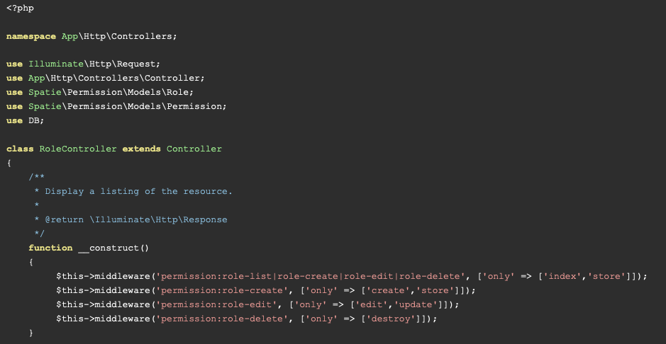
CMS Role & Permission
Step 8: RoleController

Slide 110
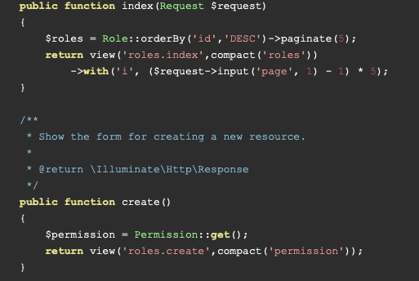
CMS Role & Permission
Step 8: RoleController

Slide 111
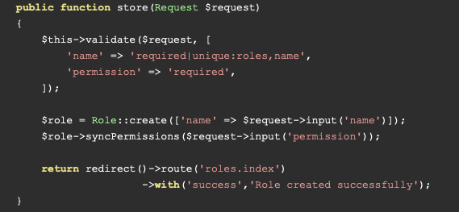
CMS Role & Permission
Step 8: RoleController

Slide 112
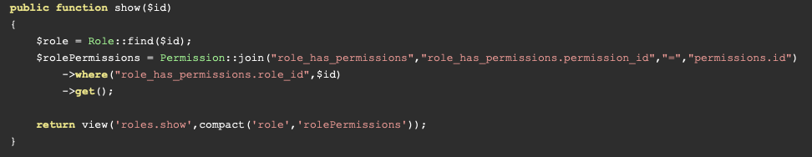
CMS Role & Permission
Step 8: RoleController

Slide 113
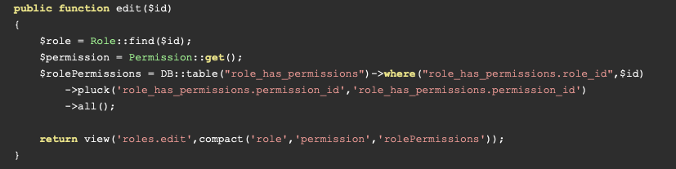
CMS Role & Permission
Step 8: RoleController

Slide 114
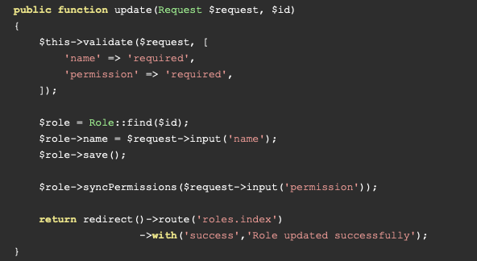
CMS Role & Permission
Step 8: RoleController

Slide 115
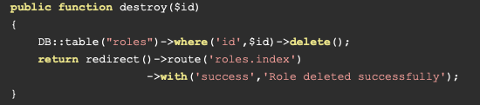
CMS Role & Permission
Step 8: RoleController

Slide 116
CMS Role & Permission
Step 9: Add Blades
In this step, we need to create following files as like listed below:
Theme Layout
app.blade.php
Users Module
index.blade.php create.blade.php edit.blade.php show.blade.php
Roles Module
index.blade.php create.blade.php edit.blade.php show.blade.php
Product Module
index.blade.php create.blade.php edit.blade.php show.blade.php

Slide 117
CMS Role & Permission
Step 9: app.blade.php
<html lang="{{ app()->getLocale() }}">
<head>
<meta charset="utf-8">
<meta http-equiv="X-UA-Compatible" content="IE=edge">
<meta name="viewport" content="width=device-width, initial-scale=1">
<!-- CSRF Token -->
<meta name="csrf-token" content="{{ csrf_token() }}">
<title>{{ config('app.name', 'Laravel 9 User Roles and Permissions Tutorial') }}</title>
<!-- Scripts -->
<script src="{{ asset('js/app.js') }}" defer></script>
<!-- Fonts -->
<link rel="dns-prefetch" href="https://fonts.gstatic.com">
<link href="https://fonts.googleapis.com/css?family=Raleway:300,400,600" rel="stylesheet" type="text/css">
<!-- Styles -->
<link href="{{ asset('css/app.css') }}" rel="stylesheet">
</head>
<body>
<div id="app">
<nav class="navbar navbar-expand-md navbar-light navbar-laravel">
<div class="container">
<a class="navbar-brand" href="{{ url('/') }}">
Laravel 9 User Roles and Permissions - ItSolutionStuff.com
</a>
<button class="navbar-toggler" type="button" data-toggle="collapse" data-target="#navbarSupportedContent" aria-controls="navbarSupportedContent" aria-expanded="false" aria-label="Toggle navigation">
<span class="navbar-toggler-icon"></span>
</button>
<div class="collapse navbar-collapse" id="navbarSupportedContent">
<!-- Left Side Of Navbar -->
<ul class="navbar-nav mr-auto"></ul>

Slide 118
CMS Role & Permission
Step 9: resources/views/layouts/app.blade.php
<!-- Right Side Of Navbar -->
<ul class="navbar-nav ml-auto">
<!-- Authentication Links -->
@guest
<li><a class="nav-link" href="{{ route('login') }}">{{ __('Login') }}</a></li>
<li><a class="nav-link" href="{{ route('register') }}">{{ __('Register') }}</a></li>
@else
<li><a class="nav-link" href="{{ route('users.index') }}">Manage Users</a></li>
<li><a class="nav-link" href="{{ route('roles.index') }}">Manage Role</a></li>
<li><a class="nav-link" href="{{ route('products.index') }}">Manage Product</a></li>
<li class="nav-item dropdown">
<a id="navbarDropdown" class="nav-link dropdown-toggle" href="#" role="button" data-toggle="dropdown" aria-haspopup="true" aria-expanded="false" v-pre>
{{ Auth::user()->name }} <span class="caret"></span>
</a>
<div class="dropdown-menu" aria-labelledby="navbarDropdown">
<a class="dropdown-item" href="{{ route('logout') }}"
onclick="event.preventDefault();
document.getElementById('logout-form').submit();">
{{ __('Logout') }}
</a>
<form id="logout-form" action="{{ route('logout') }}" method="POST" style="display: none;">
@csrf
</form>
</div>
</li>
@endguest
</ul>
</div>
</div>
</nav>
<main class="py-4">
<div class="container">
@yield('content')
</div>
</main>
</div>
</body>
</html>

Slide 119
CMS Role & Permission
Step 9: resources/views/users/index.blade.php
@extends('layouts.app')
@section('content')
<div class="row">
<div class="col-lg-12 margin-tb">
<div class="pull-left">
<h2>Users Management</h2>
</div>
<div class="pull-right">
<a class="btn btn-success" href="{{ route('users.create') }}"> Create New User</a>
</div>
</div>
</div>
@if ($message = Session::get('success'))
<div class="alert alert-success">
<p>{{ $message }}</p>
</div>
@endif
<table class="table table-bordered">
<tr>
<th>No</th>
<th>Name</th>
<th>Email</th>
<th>Roles</th>
<th width="280px">Action</th>
</tr>
@foreach ($data as $key => $user)
<tr>
<td>{{ ++$i }}</td>
<td>{{ $user->name }}</td>
<td>{{ $user->email }}</td>
<td>
@if(!empty($user->getRoleNames()))
@foreach($user->getRoleNames() as $v)
<label class="badge badge-success">{{ $v }}</label>
@endforeach
@endif
</td>
<td>
<a class="btn btn-info" href="{{ route('users.show',$user->id) }}">Show</a>
<a class="btn btn-primary" href="{{ route('users.edit',$user->id) }}">Edit</a>
{!! Form::open(['method' => 'DELETE','route' => ['users.destroy', $user->id],'style'=>'display:inline']) !!}
{!! Form::submit('Delete', ['class' => 'btn btn-danger']) !!}
{!! Form::close() !!}
</td>
</tr>
@endforeach
</table>
{!! $data->render() !!}
@endsection

Slide 120
CMS Role & Permission
Step 9: resources/views/users/create.blade.php
@extends('layouts.app')
@section('content')
<div class="row">
<div class="col-lg-12 margin-tb">
<div class="pull-left">
<h2>Create New User</h2>
</div>
<div class="pull-right">
<a class="btn btn-primary" href="{{ route('users.index') }}"> Back</a>
</div>
</div>
</div>
@if (count($errors) > 0)
<div class="alert alert-danger">
<strong>Whoops!</strong> There were some problems with your input.<br><br>
<ul>
@foreach ($errors->all() as $error)
<li>{{ $error }}</li>
@endforeach
</ul>
</div>
@endif
{!! Form::open(array('route' => 'users.store','method'=>'POST')) !!}
<div class="row">
<div class="col-xs-12 col-sm-12 col-md-12">
<div class="form-group">
<strong>Name:</strong>
{!! Form::text('name', null, array('placeholder' => 'Name','class' => 'form-control')) !!}
</div>
</div>
<div class="col-xs-12 col-sm-12 col-md-12">
<div class="form-group">
<strong>Email:</strong>
{!! Form::text('email', null, array('placeholder' => 'Email','class' => 'form-control')) !!}
</div>
</div>
<div class="col-xs-12 col-sm-12 col-md-12">
<div class="form-group">
<strong>Password:</strong>
{!! Form::password('password', array('placeholder' => 'Password','class' => 'form-control')) !!}
</div>
</div>
<div class="col-xs-12 col-sm-12 col-md-12">
<div class="form-group">
<strong>Confirm Password:</strong>
{!! Form::password('confirm-password', array('placeholder' => 'Confirm Password','class' => 'form-control')) !!}
</div>
</div>
<div class="col-xs-12 col-sm-12 col-md-12">
<div class="form-group">
<strong>Role:</strong>
{!! Form::select('roles[]', $roles,[], array('class' => 'form-control','multiple')) !!}
</div>
</div>
<div class="col-xs-12 col-sm-12 col-md-12 text-center">
<button type="submit" class="btn btn-primary">Submit</button>
</div>
</div>
{!! Form::close() !!}
@endsection

Slide 121
CMS Role & Permission
Step 9: resources/views/users/edit.blade.php
@extends('layouts.app')
@section('content')
<div class="row">
<div class="col-lg-12 margin-tb">
<div class="pull-left">
<h2>Edit New User</h2>
</div>
<div class="pull-right">
<a class="btn btn-primary" href="{{ route('users.index') }}"> Back</a>
</div>
</div>
</div>
@if (count($errors) > 0)
<div class="alert alert-danger">
<strong>Whoops!</strong> There were some problems with your input.<br><br>
<ul>
@foreach ($errors->all() as $error)
<li>{{ $error }}</li>
@endforeach
</ul>
</div>
@endif
{!! Form::model($user, ['method' => 'PATCH','route' => ['users.update', $user->id]]) !!}
<div class="row">
<div class="col-xs-12 col-sm-12 col-md-12">
<div class="form-group">
<strong>Name:</strong>
{!! Form::text('name', null, array('placeholder' => 'Name','class' => 'form-control')) !!}
</div>
</div>
<div class="col-xs-12 col-sm-12 col-md-12">
<div class="form-group">
<strong>Email:</strong>
{!! Form::text('email', null, array('placeholder' => 'Email','class' => 'form-control')) !!}
</div>
</div>
<div class="col-xs-12 col-sm-12 col-md-12">
<div class="form-group">
<strong>Password:</strong>
{!! Form::password('password', array('placeholder' => 'Password','class' => 'form-control')) !!}
</div>
</div>
<div class="col-xs-12 col-sm-12 col-md-12">
<div class="form-group">
<strong>Confirm Password:</strong>
{!! Form::password('confirm-password', array('placeholder' => 'Confirm Password','class' => 'form-control')) !!}
</div>
</div>
<div class="col-xs-12 col-sm-12 col-md-12">
<div class="form-group">
<strong>Role:</strong>
{!! Form::select('roles[]', $roles,$userRole, array('class' => 'form-control','multiple')) !!}
</div>
</div>
<div class="col-xs-12 col-sm-12 col-md-12 text-center">
<button type="submit" class="btn btn-primary">Submit</button>
</div>
</div>
{!! Form::close() !!}
@endsection

Slide 122
CMS Role & Permission
Step 9: resources/views/users/show.blade.php
@extends('layouts.app')
@section('content')
<div class="row">
<div class="col-lg-12 margin-tb">
<div class="pull-left">
<h2> Show User</h2>
</div>
<div class="pull-right">
<a class="btn btn-primary" href="{{ route('users.index') }}"> Back</a>
</div>
</div>
</div>
<div class="row">
<div class="col-xs-12 col-sm-12 col-md-12">
<div class="form-group">
<strong>Name:</strong>
{{ $user->name }}
</div>
</div>
<div class="col-xs-12 col-sm-12 col-md-12">
<div class="form-group">
<strong>Email:</strong>
{{ $user->email }}
</div>
</div>
<div class="col-xs-12 col-sm-12 col-md-12">
<div class="form-group">
<strong>Roles:</strong>
@if(!empty($user->getRoleNames()))
@foreach($user->getRoleNames() as $v)
<label class="badge badge-success">{{ $v }}</label>
@endforeach
@endif
</div>
</div>
</div>
@endsection

Slide 123
CMS Role & Permission
Step 9: resources/views/roles/index.blade.php
@extends('layouts.app')
@section('content')
<div class="row">
<div class="col-lg-12 margin-tb">
<div class="pull-left">
<h2>Role Management</h2>
</div>
<div class="pull-right">
@can('role-create')
<a class="btn btn-success" href="{{ route('roles.create') }}"> Create New Role</a>
@endcan
</div>
</div>
</div>
@if ($message = Session::get('success'))
<div class="alert alert-success">
<p>{{ $message }}</p>
</div>
@endif
<table class="table table-bordered">
<tr>
<th>No</th>
<th>Name</th>
<th width="280px">Action</th>
</tr>
@foreach ($roles as $key => $role)
<tr>
<td>{{ ++$i }}</td>
<td>{{ $role->name }}</td>
<td>
<a class="btn btn-info" href="{{ route('roles.show',$role->id) }}">Show</a>
@can('role-edit')
<a class="btn btn-primary" href="{{ route('roles.edit',$role->id) }}">Edit</a>
@endcan
@can('role-delete')
{!! Form::open(['method' => 'DELETE','route' => ['roles.destroy', $role->id],'style'=>'display:inline']) !!}
{!! Form::submit('Delete', ['class' => 'btn btn-danger']) !!}
{!! Form::close() !!}
@endcan
</td>
</tr>
@endforeach
</table>
{!! $roles->render() !!}
@endsection

Slide 124
CMS Role & Permission
Step 9: resources/views/roles/create.blade.php
@extends('layouts.app')
@section('content')
<div class="row">
<div class="col-lg-12 margin-tb">
<div class="pull-left">
<h2>Create New Role</h2>
</div>
<div class="pull-right">
<a class="btn btn-primary" href="{{ route('roles.index') }}"> Back</a>
</div>
</div>
</div>
@if (count($errors) > 0)
<div class="alert alert-danger">
<strong>Whoops!</strong> There were some problems with your input.<br><br>
<ul>
@foreach ($errors->all() as $error)
<li>{{ $error }}</li>
@endforeach
</ul>
</div>
@endif
{!! Form::open(array('route' => 'roles.store','method'=>'POST')) !!}
<div class="row">
<div class="col-xs-12 col-sm-12 col-md-12">
<div class="form-group">
<strong>Name:</strong>
{!! Form::text('name', null, array('placeholder' => 'Name','class' => 'form-control')) !!}
</div>
</div>
<div class="col-xs-12 col-sm-12 col-md-12">
<div class="form-group">
<strong>Permission:</strong>
<br/>
@foreach($permission as $value)
<label>{{ Form::checkbox('permission[]', $value->id, false, array('class' => 'name')) }}
{{ $value->name }}</label>
<br/>
@endforeach
</div>
</div>
<div class="col-xs-12 col-sm-12 col-md-12 text-center">
<button type="submit" class="btn btn-primary">Submit</button>
</div>
</div>
{!! Form::close() !!}
@endsection

Slide 125
CMS Role & Permission
Step 9: resources/views/roles/edit.blade.php
@extends('layouts.app')
@section('content')
<div class="row">
<div class="col-lg-12 margin-tb">
<div class="pull-left">
<h2>Edit Role</h2>
</div>
<div class="pull-right">
<a class="btn btn-primary" href="{{ route('roles.index') }}"> Back</a>
</div>
</div>
</div>
@if (count($errors) > 0)
<div class="alert alert-danger">
<strong>Whoops!</strong> There were some problems with your input.<br><br>
<ul>
@foreach ($errors->all() as $error)
<li>{{ $error }}</li>
@endforeach
</ul>
</div>
@endif
{!! Form::model($role, ['method' => 'PATCH','route' => ['roles.update', $role->id]]) !!}
<div class="row">
<div class="col-xs-12 col-sm-12 col-md-12">
<div class="form-group">
<strong>Name:</strong>
{!! Form::text('name', null, array('placeholder' => 'Name','class' => 'form-control')) !!}
</div>
</div>
<div class="col-xs-12 col-sm-12 col-md-12">
<div class="form-group">
<strong>Permission:</strong>
<br/>
@foreach($permission as $value)
<label>{{ Form::checkbox('permission[]', $value->id, in_array($value->id, $rolePermissions) ? true : false, array('class' => 'name')) }}
{{ $value->name }}</label>
<br/>
@endforeach
</div>
</div>
<div class="col-xs-12 col-sm-12 col-md-12 text-center">
<button type="submit" class="btn btn-primary">Submit</button>
</div>
</div>
{!! Form::close() !!}
@endsection

Slide 126
CMS Role & Permission
Step 9: resources/views/roles/show.blade.php
@extends('layouts.app')
@section('content')
<div class="row">
<div class="col-lg-12 margin-tb">
<div class="pull-left">
<h2> Show Role</h2>
</div>
<div class="pull-right">
<a class="btn btn-primary" href="{{ route('roles.index') }}"> Back</a>
</div>
</div>
</div>
<div class="row">
<div class="col-xs-12 col-sm-12 col-md-12">
<div class="form-group">
<strong>Name:</strong>
{{ $role->name }}
</div>
</div>
<div class="col-xs-12 col-sm-12 col-md-12">
<div class="form-group">
<strong>Permissions:</strong>
@if(!empty($rolePermissions))
@foreach($rolePermissions as $v)
<label class="label label-success">{{ $v->name }},</label>
@endforeach
@endif
</div>
</div>
</div>
@endsection

Slide 127
If you wandering why we have Products Blade again, We need to modify the Products Blades for Role & Permission

Slide 128
CMS Role & Permission
Step 9: resources/views/products/index.blade.php
@extends('layouts.app')
@section('content')
<div class="row">
<div class="col-lg-12 margin-tb">
<div class="pull-left">
<h2>Products</h2>
</div>
<div class="pull-right">
@can('product-create')
<a class="btn btn-success" href="{{ route('products.create') }}"> Create New Product</a>
@endcan
</div>
</div>
</div>
@if ($message = Session::get('success'))
<div class="alert alert-success">
<p>{{ $message }}</p>
</div>
@endif
<table class="table table-bordered">
<tr>
<th>No</th>
<th>Name</th>
<th>Details</th>
<th width="280px">Action</th>
</tr>
@foreach ($products as $product)
<tr>
<td>{{ ++$i }}</td>
<td>{{ $product->name }}</td>
<td>{{ $product->detail }}</td>
<td>
<form action="{{ route('products.destroy',$product->id) }}" method="POST">
<a class="btn btn-info" href="{{ route('products.show',$product->id) }}">Show</a>
@can('product-edit')
<a class="btn btn-primary" href="{{ route('products.edit',$product->id) }}">Edit</a>
@endcan
@csrf
@method('DELETE')
@can('product-delete')
<button type="submit" class="btn btn-danger">Delete</button>
@endcan
</form>
</td>
</tr>
@endforeach
</table>
{!! $products->links() !!}
@endsection

Slide 129
CMS Role & Permission
Step 9: resources/views/products/create.blade.php
@extends('layouts.app')
@section('content')
<div class="row">
<div class="col-lg-12 margin-tb">
<div class="pull-left">
<h2>Add New Product</h2>
</div>
<div class="pull-right">
<a class="btn btn-primary" href="{{ route('products.index') }}"> Back</a>
</div>
</div>
</div>
@if ($errors->any())
<div class="alert alert-danger">
<strong>Whoops!</strong> There were some problems with your input.<br><br>
<ul>
@foreach ($errors->all() as $error)
<li>{{ $error }}</li>
@endforeach
</ul>
</div>
@endif
<form action="{{ route('products.store') }}" method="POST">
@csrf
<div class="row">
<div class="col-xs-12 col-sm-12 col-md-12">
<div class="form-group">
<strong>Name:</strong>
<input type="text" name="name" class="form-control" placeholder="Name">
</div>
</div>
<div class="col-xs-12 col-sm-12 col-md-12">
<div class="form-group">
<strong>Detail:</strong>
<textarea class="form-control" style="height:150px" name="detail" placeholder="Detail"></textarea>
</div>
</div>
<div class="col-xs-12 col-sm-12 col-md-12 text-center">
<button type="submit" class="btn btn-primary">Submit</button>
</div>
</div>
</form>
@endsection

Slide 130
CMS Role & Permission
Step 9: resources/views/products/edit.blade.php
@extends('layouts.app')
@section('content')
<div class="row">
<div class="col-lg-12 margin-tb">
<div class="pull-left">
<h2>Edit Product</h2>
</div>
<div class="pull-right">
<a class="btn btn-primary" href="{{ route('products.index') }}"> Back</a>
</div>
</div>
</div>
@if ($errors->any())
<div class="alert alert-danger">
<strong>Whoops!</strong> There were some problems with your input.<br><br>
<ul>
@foreach ($errors->all() as $error)
<li>{{ $error }}</li>
@endforeach
</ul>
</div>
@endif
<form action="{{ route('products.update',$product->id) }}" method="POST">
@csrf
@method('PUT')
<div class="row">
<div class="col-xs-12 col-sm-12 col-md-12">
<div class="form-group">
<strong>Name:</strong>
<input type="text" name="name" value="{{ $product->name }}" class="form-control" placeholder="Name">
</div>
</div>
<div class="col-xs-12 col-sm-12 col-md-12">
<div class="form-group">
<strong>Detail:</strong>
<textarea class="form-control" style="height:150px" name="detail" placeholder="Detail">{{ $product->detail }}</textarea>
</div>
</div>
<div class="col-xs-12 col-sm-12 col-md-12 text-center">
<button type="submit" class="btn btn-primary">Submit</button>
</div>
</div>
</form>
@endsection

Slide 131
CMS Role & Permission
Step 9: resources/views/products/show.blade.php
@extends('layouts.app')
@section('content')
<div class="row">
<div class="col-lg-12 margin-tb">
<div class="pull-left">
<h2> Show Product</h2>
</div>
<div class="pull-right">
<a class="btn btn-primary" href="{{ route('products.index') }}"> Back</a>
</div>
</div>
</div>
<div class="row">
<div class="col-xs-12 col-sm-12 col-md-12">
<div class="form-group">
<strong>Name:</strong>
{{ $product->name }}
</div>
</div>
<div class="col-xs-12 col-sm-12 col-md-12">
<div class="form-group">
<strong>Details:</strong>
{{ $product->detail }}
</div>
</div>
</div>
@endsection

Slide 132
CMS Role & Permission
Step 10: Create Seed For Permission & Admin User
In this step we will create seeder for permissions, Right now we have fixed permission so we create using seeder as listed bellow, but if you can add more permission as you want:
1.role-list
2.role-create
3.role-edit
4.role-delete
5.product-list
6.product-create
7.product-edit
8.product-delete
So, first create seeder using bellow command: Terminal> php artisan make:seeder PermissionTableSeeder

Slide 133
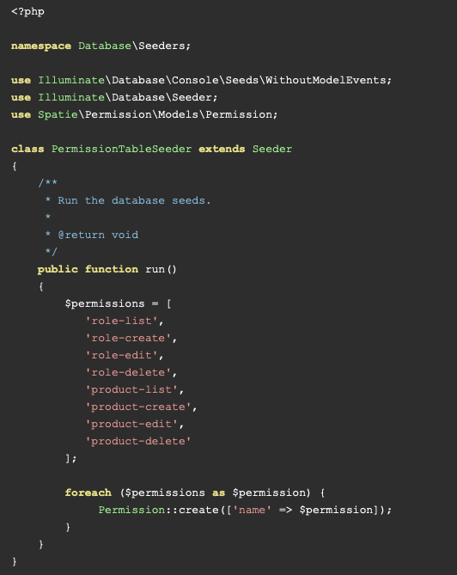
CMS Role & Permission
Step 10: Create Seed For Permission & Admin User
And put below code in PermissionTableSeeder seeder this way:
database/seeders/PermissionTableSeeder.php

Slide 134
CMS Role & Permission
Step 10: Create Seed For Permission & Admin User
After this we have to run below command for run PermissionTableSeeder seeder: Terminal> php artisan db:seed —class=PermissionTableSeeder

Slide 135
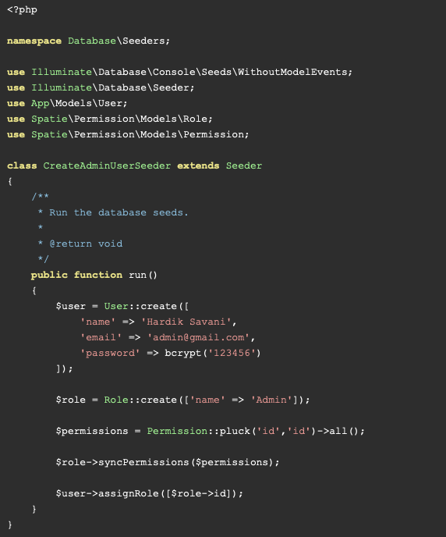
CMS Role & Permission
Step 10: Create Seed For Permission & Admin User
Now let's create new seeder for creating admin user:
Terminal> php artisan make:seeder CreateAdminUserSeeder

Slide 136
CMS Role & Permission
Step 10: Create Seed For Permission & Admin User
We run this: Terminal> php artisan db:seed --class=CreateAdminUserSeeder

Slide 137
CMS Role & Permission
Step 11: Finally
We run this: Terminal> php artisan serve

